Slide 1
DATA SCIENCE
11 WEEK PART TIME COURSE
Week 4 - Model Evaluation
Monday 11th April 2016

Slide 2
AGENDA
Evaluating machine learning models
Why is this important?
Correctly assessing the accuracy of a model
Lab
Review

Slide 3
REVIEW
DATA SCIENCE PART TIME COURSE

Slide 4
TRAINING ERROR
Q: What’s wrong with training error?
Thought experiment:
Suppose we train our model using the entire dataset.
Q: How low can we push the training error?
We can make the model arbitrarily complex (effectively “memorizing” the entire training set).
A: Down to zero!

Slide 5
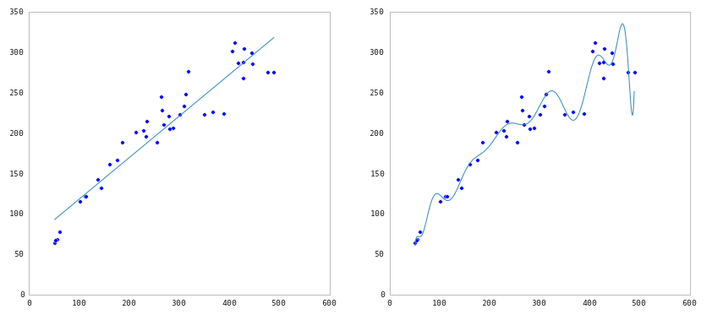
TRAINING ERROR

Slide 6
TRAINING ERROR
Q: What’s wrong with training error?
Thought experiment:
Suppose we train our model using the entire dataset.
Q: How low can we push the training error?
We can make the model arbitrarily complex (effectively
“memorizing” the entire training set).
A: Down to zero!
A: Training error is not a good estimate of
accuracy beyond training data.

Slide 7
TRAINING ERROR
Why this matters
The data that we are given for prediction won’t always be the end of the data we are interested in! We may not have access to all the data of interest
We will gather data and build and iterate over models however a main reason for building the model was to predict unseen test cases.

Slide 8

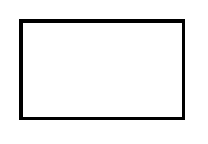
TEST SET APPROACH
Q: How can we make a model that generalizes well?
model
dataset

Slide 9
TEST SET APPROACH
Q: How can we make a model that generalizes well?
1) split dataset
model
dataset

Slide 10

TEST SET APPROACH
Q: How can we make a model that generalizes well?
1) split dataset
2) train model
training set
model
dataset

Slide 11

TEST SET APPROACH
Q: How can we make a model that generalizes well?
1) split dataset
2) train model
3) test model
training set
model
test set
dataset

Slide 12
TEST SET APPROACH
Q: How can we make a model that generalizes well?
1) split dataset
2) train model
3) test model
4) parameter tuning
training set
model
test set
dataset

Slide 13
TEST SET APPROACH
Q: How can we make a model that generalizes well?
1) split dataset
2) train model
3) test model
4) parameter tuning
5) choose best model
training set
model
test set
dataset

Slide 14
TEST SET APPROACH
Q: How can we make a model that generalizes well?
1) split dataset
2) train model
3) test model
4) parameter tuning
5) choose best model
6) train on all data
training set
model
test set
dataset

Slide 15

TEST SET APPROACH
Q: How can we make a model that generalizes well?
1) split dataset
2) train model
3) test model
4) parameter tuning
5) choose best model
6) train on all data
7) make predictions
on new data
training set
model
test set
new data
dataset

Slide 16

TEST SET APPROACH
Q: How can we make a model that generalizes well?
1) split dataset
2) train model
3) test model
4) parameter tuning
5) choose best model
6) train on all data
7) make predictions
on new data
NOTE
This new data is called out of sample data. We don’t know the labels for these OOS records!
We want to estimate OOS prediction error so we know what to expect from our model.
training set
model
test set
new data
dataset

Slide 17
TEST SET APPROACH
Suppose we do the train/test split.
Q: How well does test set error predict OOS?
Thought experiment:
Suppose we had done a different train/test split.
Q: Would the test set error remain the same?
A: Of course not!
A: On its own, not very well.

Slide 18
TEST SET APPROACH
TEST SET APPROACH
Suppose we do the train/test split.
Q: How well does test set error predict OOS?
Thought experiment:
Suppose we had done a different train/test split.
Q: Would the test set error remain the same?
A: Of course not!
A: On its own, not very well.
NOTE
The test set error gives a high-variance estimate of OOS accuracy.

Slide 19
TEST SET APPROACH
Something is still missing!
Q: How can we do better?
Thought experiment:
Different train/test splits will give us different test set errors.
Q: What if we did a bunch of these and took the average?
A: Now you’re talking!
A: Cross-validation.

Slide 20
CROSS VALIDATION
Steps for K-fold cross-validation:
Randomly split the dataset into K equal partitions.
Use partition 1 as test set & union of other partitions as training set.
Calculate test set error.
Repeat steps 2-3 using a different partition as the test set at each iteration.
5) Take the average test set error as the estimate of OOS accuracy.

Slide 21
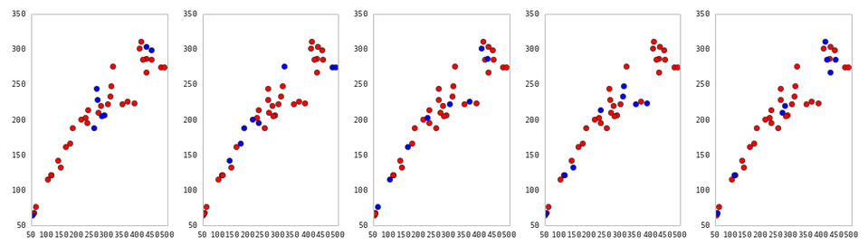
CROSS VALIDATION
5-fold cross-validation: red = training folds, blue = test fold
Source: http://nbviewer.ipython.org/github/fonnesbeck/Bios366/blob/master/notebooks/Section6_3-Model-Selection-and-Validation.ipynb

Slide 22
CROSS VALIDATION
Features of K-fold cross-validation:
More accurate estimate of OOS prediction error.
More efficient use of data than single train/test split. - Each record in our dataset is used for both training and testing.
Presents tradeoff between efficiency an computational expense. - 10-fold CV is 10x more expensive than a single train/test split
Can be used for parameter tuning and model selection.

Slide 23
BIAS - VARIANCE TRADEOFF
Errors due to Bias
When we are training over multiple data sets we will have different errors. Bias measures how far off we are in general the predictions are from the actual values
Errors due to Variance
This is how variable our model is for a given data point. The variance calculates how much the predicted are from the actual values

Slide 24
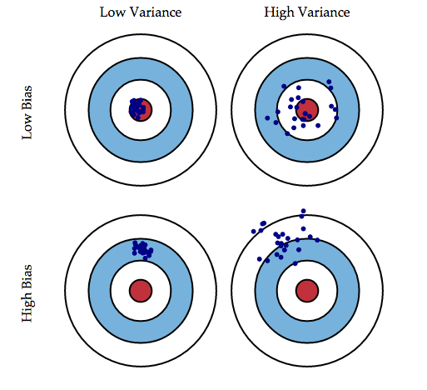
BIAS - VARIANCE TRADEOFF
￼

Slide 25

BIAS - VARIANCE TRADEOFF

Slide 26
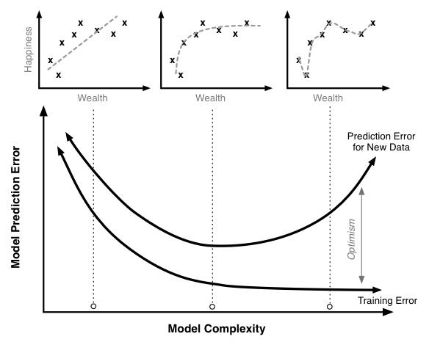
BIAS - VARIANCE TRADEOFF

Slide 27
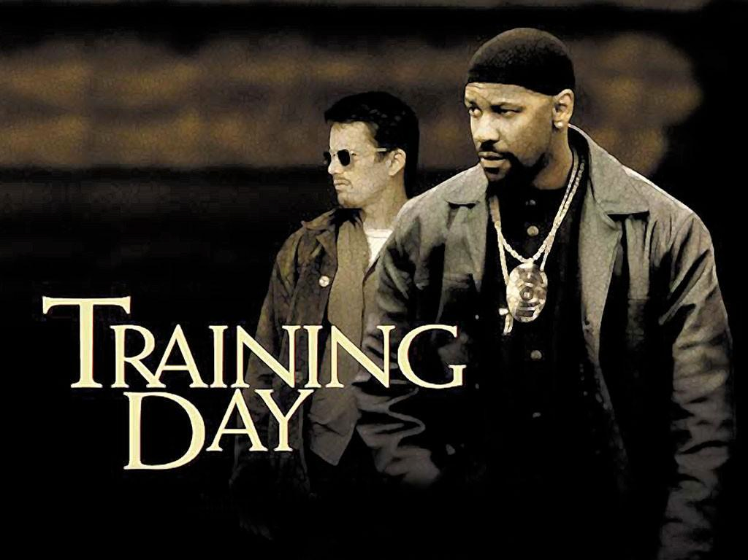

LAB
DATA SCIENCE PART TIME COURSE

Slide 28
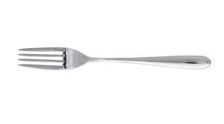
SYNCHING A FORK
git remote -v
git remote add upstream https://github.com/ihansel/SYD_DAT_4.git
git remote -v
git fetch upstream
git checkout master
git merge upstream/master
git merge branch -X upstream (if the above line doesn’t work)

Slide 29
DISCUSSION TIME
DATA SCIENCE - Week 3 Day 2
DISCUSSION TIME
Questions from previous lesson?
Further Reading for Model Evaluation
Check in with homework
Tasks for next lesson

Slide 30
WEEK 4 Monday

Slide 31
WEEK 4 Monday
QUESTIONS
What are we trying to do when we use Logistic Regression?
Why use it instead of Linear Regression for classification?
Evaluating a logistic Regression model

Slide 32
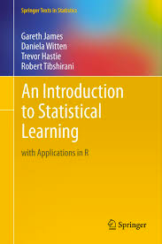
DISCUSSION TIME
An Introduction to Statistical Learning
Chapter 5 -Resampling Techniques
Logistic Regression applied to loan applications
https://github.com/nborwankar/LearnDataScience
Odds Ratio in Logistic Regression
http://www.ats.ucla.edu/stat/mult_pkg/faq/general/odds_ratio.htm
DATA SCIENCE - Week 3 Day 2

Slide 33
Tasks for Wednesday 13th April ( < 30 mins )
Read and work though the code on this website on your own machine (copy and run) http://www.datarobot.com/blog/regularized-linear-regression-with-scikit-learn/
Write out your computer specs (RAM, Hard Drive and CPU)
Fill in a Class Survey / Exit Ticket
DATA SCIENCE - Week 4 Day 1

